Slide 1
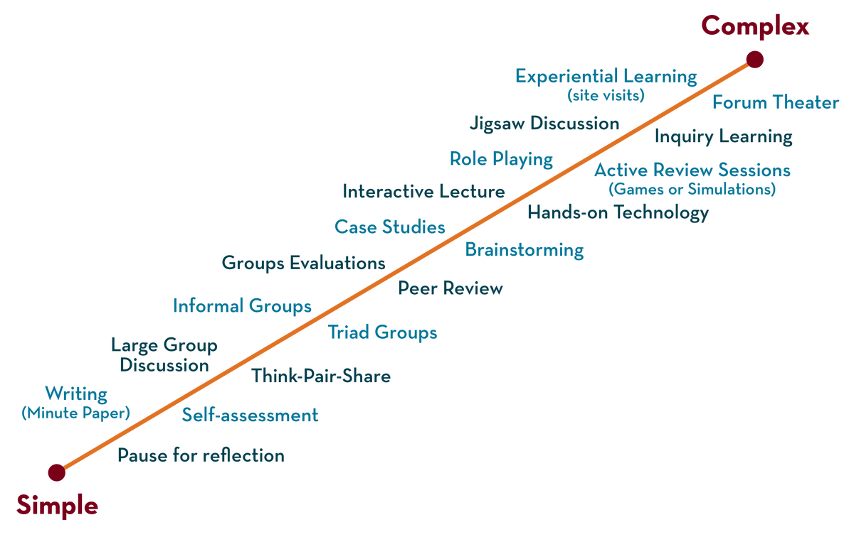
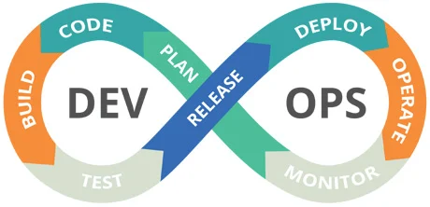

23sdcs13A/R
CI/CD and Cloud devops
Topic:
Dockerize Fullstack App from Git Repos
Dr. suneetha Bulla

